Slide 1
Reinforcement Learning, Clustering
David Quigley
CSCI 5622
2021 Fall

Slide 2
Tuesday

Slide 3

Course Logistics
Problem Set 3 – Due November 2
Problem Set 4 Launched
Grading Scale still TBD
Project Pitch Feedback – Due “November 4”
We really just want everyone to get feedback. As quick as you can, but starting Nov. 5 we’ll start following up, not giving 0s.
Project 3: Check-In is now posted (Due November 11)
This is a small activity as well! Don’t freak out over it, it should feel like it is nothing but beneficial.

Slide 4
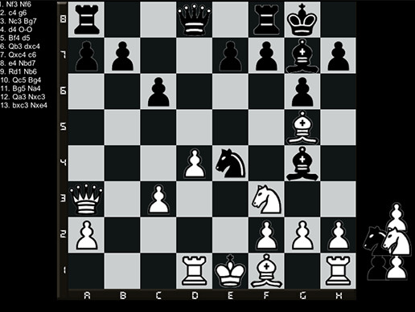

Defining Our Problem Space
Agent – A decision-making entity
Environment – The space in which the Agent is making decisions
State (S) – The current status of the Environment
Goal – An eventual outcome sought by the Agent
Reward (R) – Intermediate measure of success/failure towards the Goal
Action (A) – The options available to the Agent to change the State

Slide 5
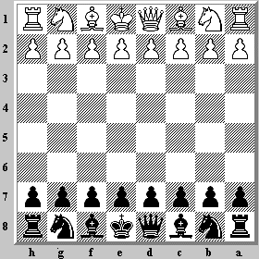
Action & State are Linked
What’s possible? vs
What’s effective?

Slide 6
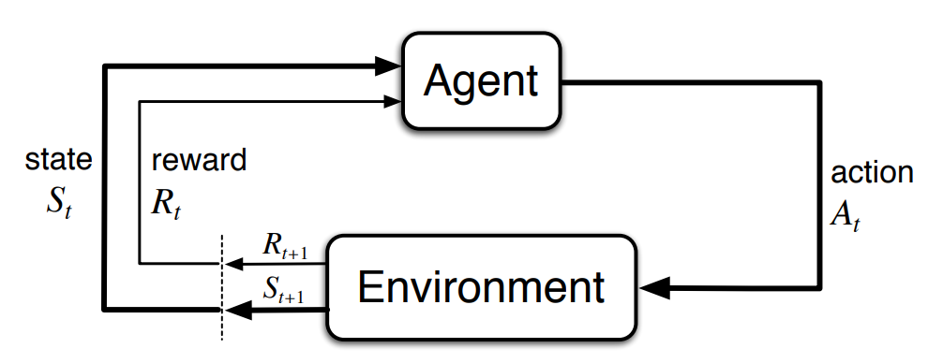
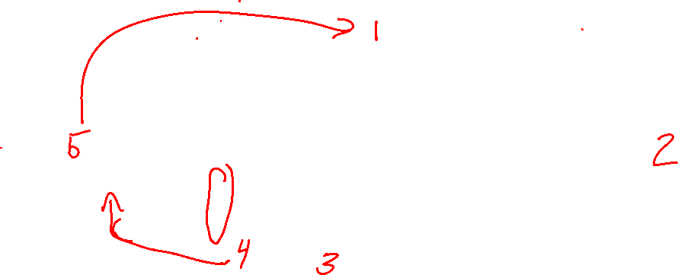
Markov Decision Processes
Notes:
http://incompleteideas.net/book/bookdraft2017nov5.pdf

Slide 7
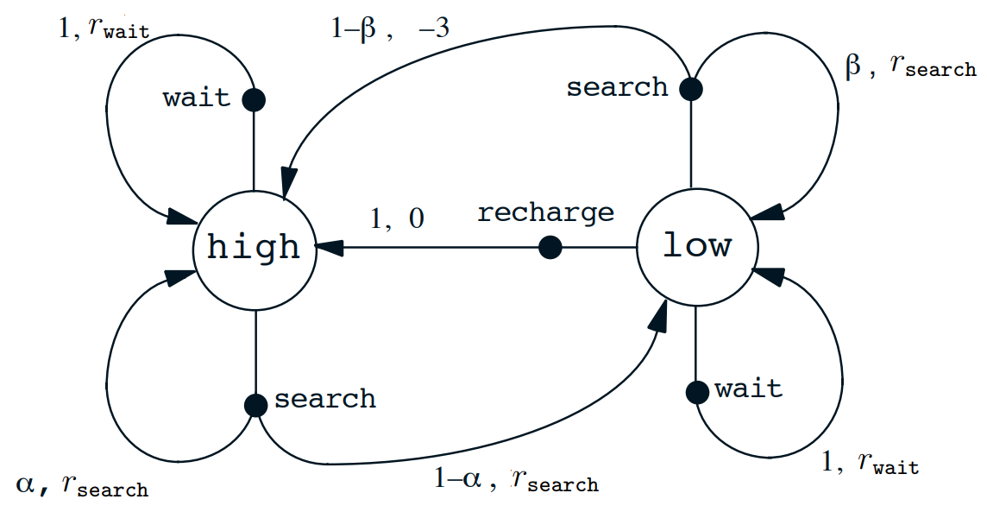
Markov Decision Process

Slide 8
Action + State = Policy
Policy (π) – The mapping of state to action

Slide 9
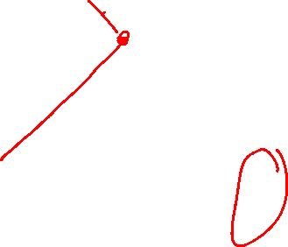
Expanding Reward
Reward – An intermediate measure of success / failure towards the Goal

Slide 10
Expanding Reward
Reward – An intermediate measure of success / failure towards the Goal
Immediate & Future Rewards must both be considered

Slide 11
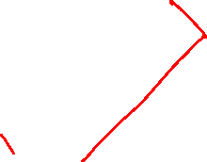
Expanding Reward
Reward – An intermediate measure of success / failure towards the Goal
Immediate & Future Rewards must both be considered
Value (V) – The expected long-term return based on an action from this current state

Slide 12
Expanding Reward
Reward – An intermediate measure of success / failure towards the Goal
Immediate & Future Rewards must both be considered
Value (V) – The expected long-term return of the current state (in terms of our policy π)
V(S) = Immediate Reward +
(Future Reward * Discount Factor)

Slide 13
Dealing with Value
A variety of factors can be given positive value
- distance to target

Slide 14
Dealing with Value
A variety of factors can be given positive value
- distance to target
- existing intermediate rewards
- chess: removing an enemy piece
- video game: coin, powerup

Slide 15
Dealing with Value
A variety of factors can be given negative value
- bad “goals”
- game over, putting yourself into checkmate

Slide 16
Dealing with Value
A variety of factors can be given negative value
- bad “goals”
- game over, putting yourself into checkmate
- bad intermediate moves
- losing a piece

Slide 17
Dealing with Value
A variety of factors can be given negative value
- bad “goals”
- game over, putting yourself into checkmate
- bad intermediate moves
- losing a piece
- effort
- any move can have cost

Slide 18
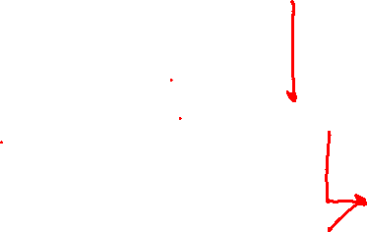
Dealing with Value
Black is considering two options
- Knight to F2
- Queen to D5
What happens if we value capturing pieces highly?
What happens if we avoid risk?

Slide 19
Dealing with Value
Black is considering two options
- Knight to F2
- Queen to D5
What happens if we value capturing pieces highly?
What happens if we avoid risk?
What happens 5 moves out???

Slide 20
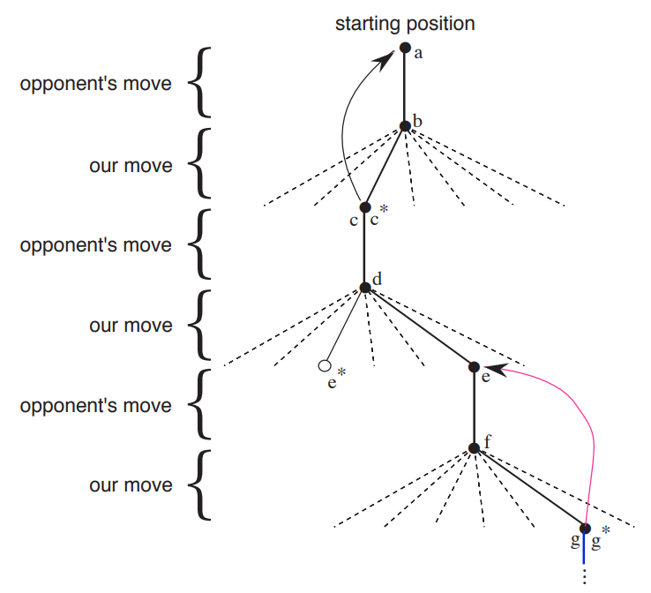
Expanding Reward
Each possible action can generate a Value (V)

Slide 21
Expanding Reward
Each possible action can generate a Value (V)
Q-Value is the long-term return of a (State, Action) pair

Slide 22
Q ~ Decision Boundary
Q maps state + action = reward
From a state, choose the action with the best Q Value!

Slide 23
Q ~ Final Model
Q maps state + action = reward
From a state, choose the action with the best Q Value!

Slide 24
Developing Q

Slide 25
Developing Q
We have two feature sets to optimize
- Values for states
- Policies for how to act

Slide 26
Developing Q
We have two feature sets to optimize
- Values for states
- Policies for how to act
à la Backpropagation, let’s iterate through each one in turn!

Slide 27
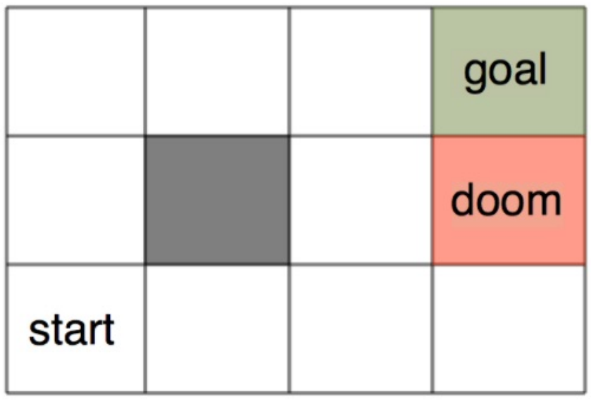
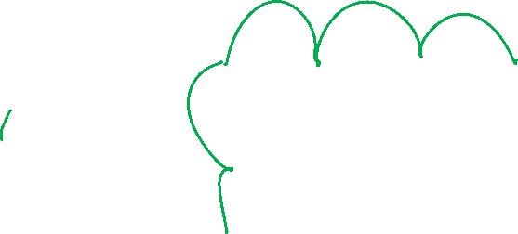
Developing Q – a Probabilistic Approach
Consider a maze world. How will our agent get from start to goal, without hitting doom?

Slide 28
Developing Q – a Probabilistic Approach
Consider a maze world. How will our agent get from start to goal, without hitting doom?
(Yes, we could write a set of instructions for this world. But it could get too complicated, especially in a bigger world!)

Slide 29
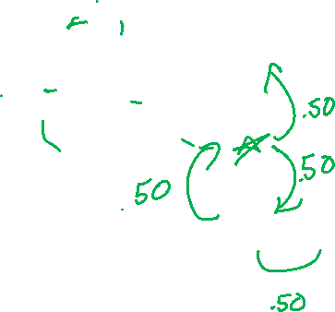
Developing Q – a Probabilistic Approach
Consider a maze world. How will our agent get from start to goal, without hitting doom?
Move at random into a new space!

Slide 30
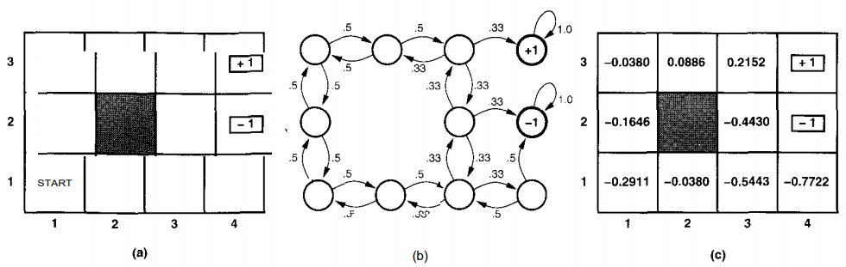

Developing Q – Updating Value
Notes:
https://www.cin.ufpe.br/~tfl2/artificial-intelligence-modern-approach.9780131038059.25368.pdf

Slide 31

Developing Q – Updating Value
Calculate out the probability of success or failure at each point
Notes:
https://www.cin.ufpe.br/~tfl2/artificial-intelligence-modern-approach.9780131038059.25368.pdf

Slide 32

Developing Q – Updating Value
Calculate out the probability of success or failure at each point
Notes:
https://www.cin.ufpe.br/~tfl2/artificial-intelligence-modern-approach.9780131038059.25368.pdf

Slide 33
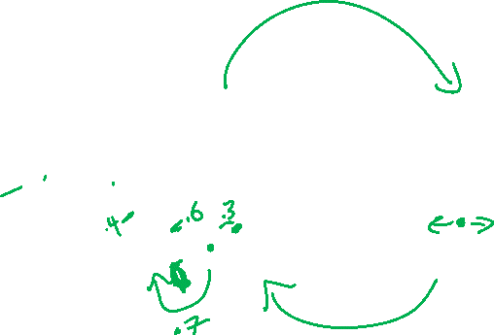
Developing Q – Updating Policy
You can use this approach to feed back into your decision policies!
Notes:
https://www.cin.ufpe.br/~tfl2/artificial-intelligence-modern-approach.9780131038059.25368.pdf

Slide 34
Problems to Address
Dealing with the problem of scale
Choosing our “features” to represent state
- easy in games, hard in the real world
Generalization

Slide 35
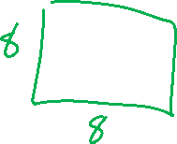
Dealing with Scale
How many States are there in the game of chess?
Notes:
https://math.stackexchange.com/questions/1406919/how-many-legal-states-of-chess-exists

Slide 36
Dealing with Scale
How many States are there in the game of chess?
7.7 * 10⁴⁵ according to John Tromp…
How much memory storage do you have?
Notes:
https://math.stackexchange.com/questions/1406919/how-many-legal-states-of-chess-exists

Slide 37
Dealing with Scale
How many States are there in the game of chess?
7.7 * 10⁴⁵ according to John Tromp…
How much memory storage do you have?
5e11(500 GB)? 1e12(1TB)?
We’re not approaching the storage capacity to actually hold all states!
Notes:
https://math.stackexchange.com/questions/1406919/how-many-legal-states-of-chess-exists

Slide 38

Scale – Monte Carlo Estimation
Instead of mapping out the full probability space, let’s generate a bunch of sample uses of our policy (to end-state) and use the outcomes to determine value!
Notes:
https://thumbs.gfycat.com/BetterThankfulEnglishsetter-max-1mb.gif

Slide 39
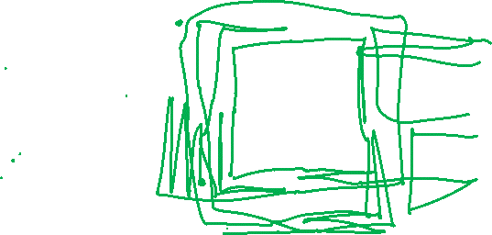
Developing Q – Monte Carlo

Slide 40
Scale – Temporal Differences
Instead of updating our value based on end-probability, we should update our value based on t+1’s probability

Slide 41
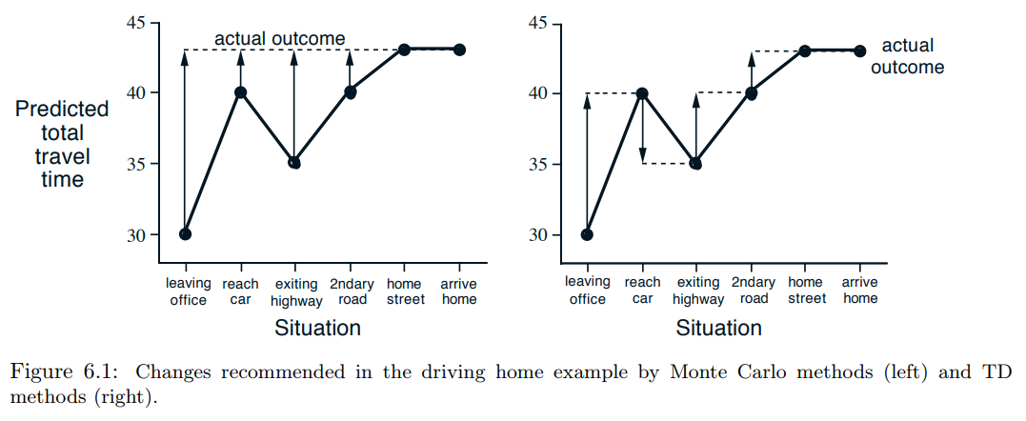

Monte Carlo vs. Temporal Difference

Slide 42
Developing Q – Temporal Differences

Slide 43

Problems to Address
Dealing with the problem of scale
Choosing our “features” to represent state
- easy in games, hard in the real world
Generalization

Slide 44
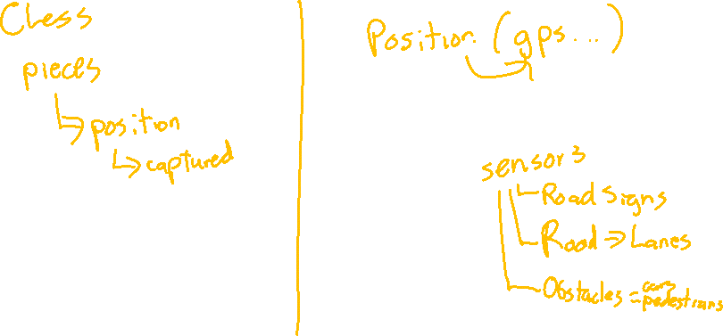
Problem Space Representation - Features

Slide 45
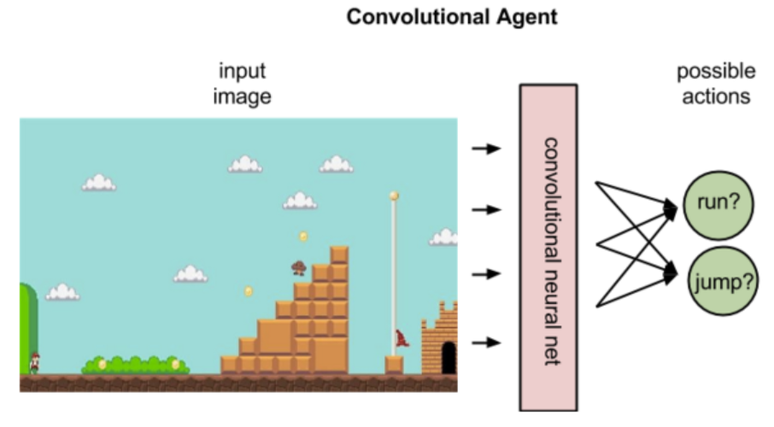
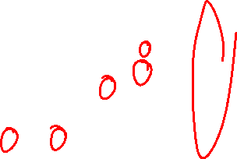
Problem Space – Video Games
Notes:
https://skymind.ai/wiki/deep-reinforcement-learning

Slide 46

Problems to Address
Dealing with the problem of scale
Choosing our “features” to represent state
- easy in games, hard in the real world
Generalization

Slide 47
Generalization
How have we avoided problems with missing samples in the past?

Slide 48
Generalization
How have we avoided problems with missing samples in the past?
Think back to Week 2!

Slide 49

Overfitting Solutions - Smoothing
Builds on the assumption that “nothing is impossible”
Notes:
https://media.giphy.com/media/cT9tZDsVQL1II/giphy.gif

Slide 50
Clustering

Slide 51
Supervised vs. Unsupervised Learning
Supervised – ground truth X (features), Y (answer)
- Trying to get a machine to predict Y based on X
- Building / implementing a function to map X to Y
- Trying to capture the hidden structure

Slide 52
Supervised vs. Unsupervised Learning
Supervised – ground truth X (features), Y (answer)
- Trying to get a machine to predict Y based on X
- Building / implementing a function to map X to Y
- Trying to capture the hidden structure
Discrete Continuous
Classification Regression
- divide my samples into classes - generate a continuous value

Slide 53
Supervised vs. Unsupervised Learning
Supervised – ground truth X, Y
- Trying to get a machine to predict Y based on X
- Building / implementing a function to map X to Y
- Trying to capture the hidden structure
Unsupervised – ground truth X
- No ground truth Y*
- Building / implementing a function to model hidden structure
*Ground truth may actually exist, we just a) can’t capture it, or b) are choosing to not use it for our task

Slide 54
Clustering
Clustering – ground truth X
- No ground truth Y*
- Trying to develop classes from the bottom up
- Trying to build based on hidden structure
*Ground truth may actually exist, we just a) can’t capture it, or b) are choosing to not use it for our task

Slide 55
Clustering
Clustering – ground truth X
- No ground truth Y*
- Trying to develop classes from the bottom up
- Trying to build based on hidden structure
Finding clusters such that
- Examples within a cluster are similar
- Examples between clusters are dissimilar
*Ground truth may actually exist, we just a) can’t capture it, or b) are choosing to not use it for our task

Slide 56


Clustering Examples

Slide 57
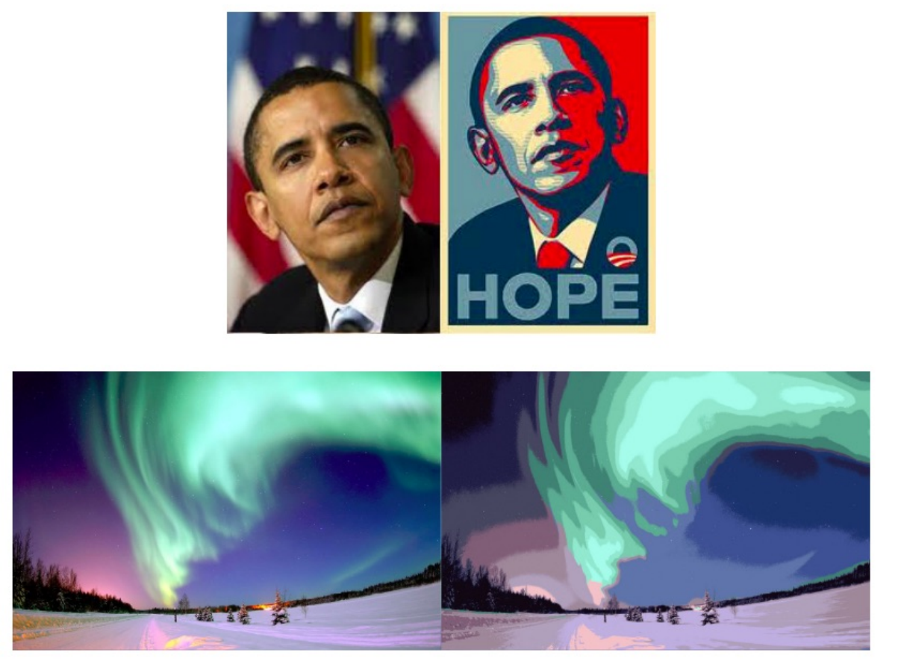
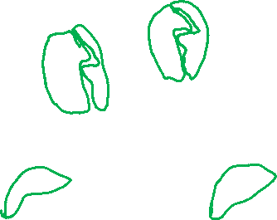
Clustering Examples

Slide 58
Clustering
Clustering – ground truth X
- No ground truth Y*
- Trying to develop classes from the bottom up
- Trying to build based on hidden structure
Finding clusters such that
- Examples within a cluster are similar
- Examples between clusters are dissimilar
*Ground truth may actually exist, we just a) can’t capture it, or b) are choosing to not use it for our task

Slide 59
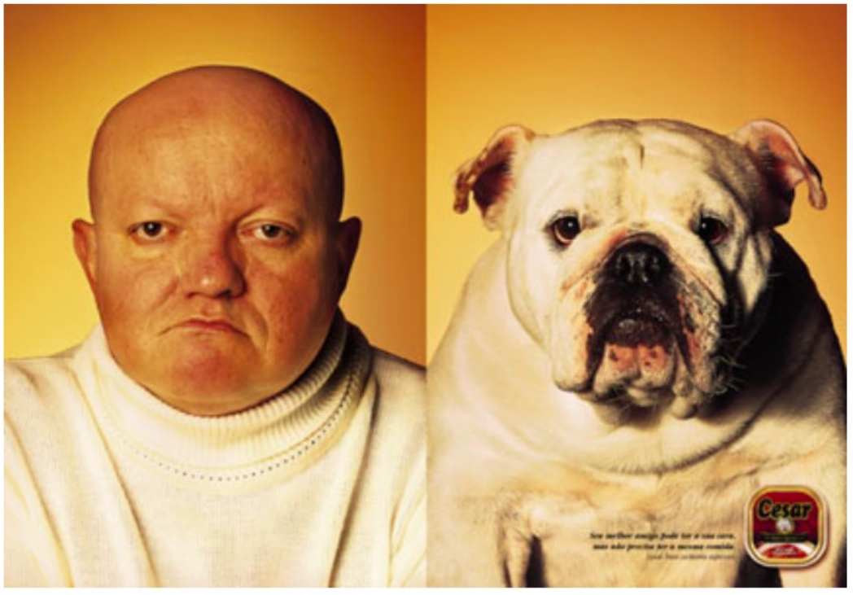
Clustering – Examples of Similarity
Eyeball test

Slide 60
Clustering – Examples of Similarity
Eyeball test
Not something we can calculate

Slide 61
Clustering – Examples of Similarity
Euclidian Distance = ||x – y ||²

Slide 62
Clustering – Examples of Similarity
Euclidian Distance = ||x – y ||²
Edit Distance: Number of character changes (insert, delete, edit) to convert string x to string y

Slide 63

Clustering – Examples of Similarity
Euclidian Distance = ||x – y ||²
Edit Distance: Number of character changes (insert, delete, edit) to convert string x to string y
Sit to Cart
Cit
Cat
Cart

Slide 64
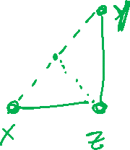
Clustering – Similarity Rules
Given a distance measure d(x,y)
Symmetry: d(x,y) = d(y,x)
Self Consistency: d(x,x) = 0
Positivity: d(x,y) = 0 if x = y
Triangle Inequality: d(x,y) <= d(x,z) + d(z,y)

Slide 65
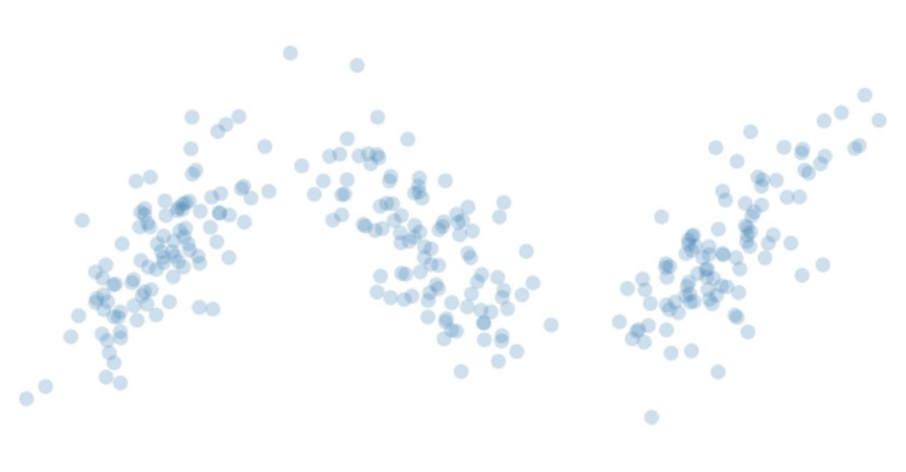
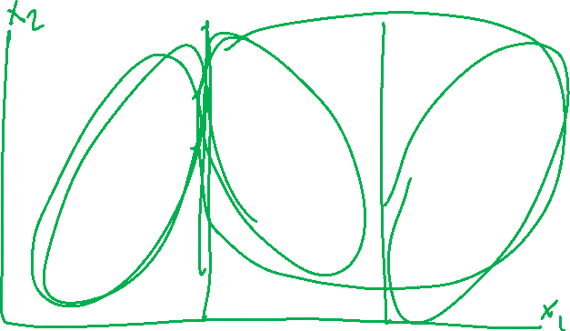
Clustering – K Means
Start with your Data

Slide 66
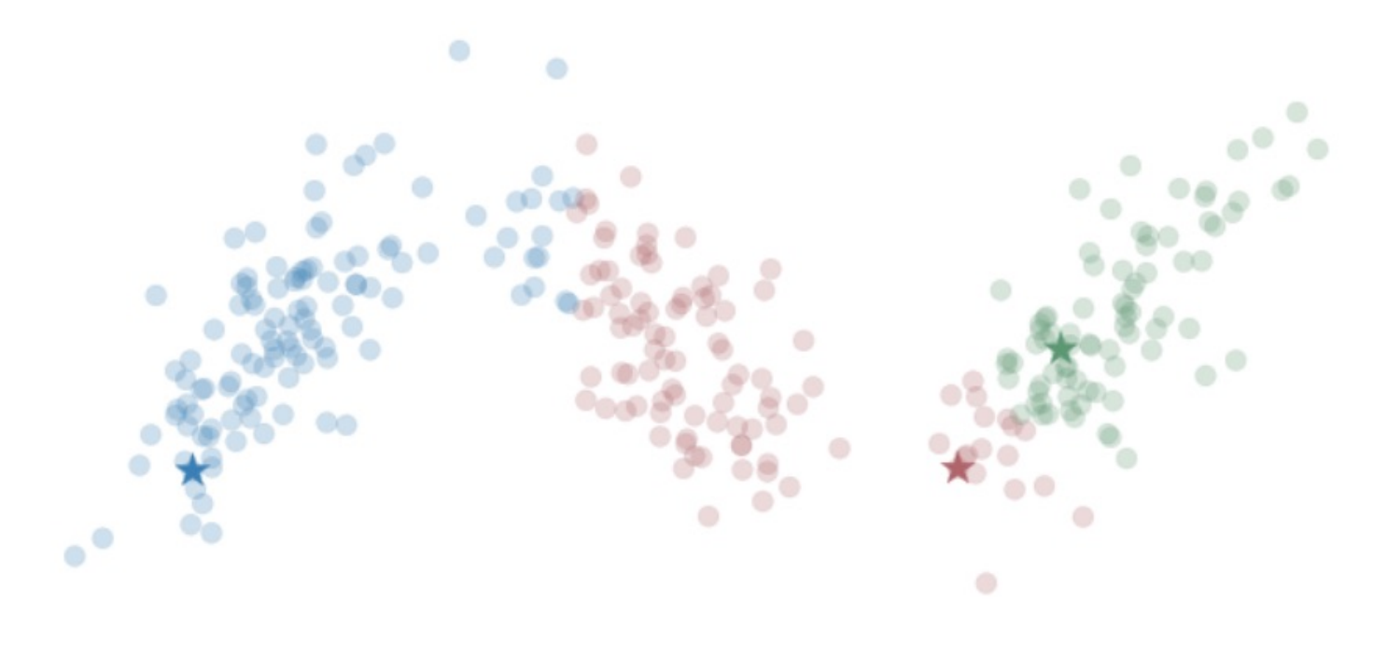
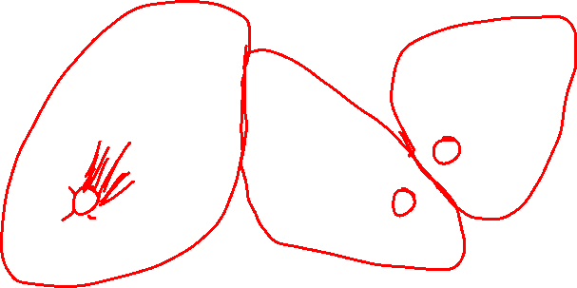
Clustering – K Means
Start with your Data
Choose K centroids
(means)
Assign each point to its
nearest cluster

Slide 67
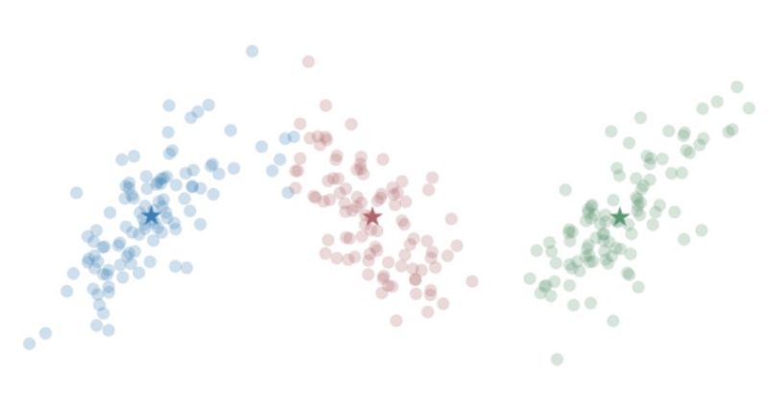
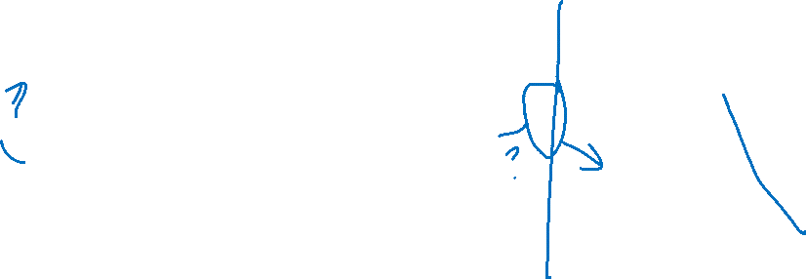
Clustering – K Means
Start with your Data
Choose K centroids
(means)
Assign each point to its
nearest cluster
Re-center your centroids
(means)

Slide 68
Clustering – K Means
Start with your Data
Choose K centroids
Until we converge:
Reassign points
Re-center

Slide 69
Thursday

Slide 70
Course Logistics
Problem Set 4 Launched
Grading Scale set
Project Pitch Feedback – Due “November 4”
We really just want everyone to get feedback. As quick as you can, but starting Nov. 5 we’ll start following up, not giving 0s.
Project 3: Check-In is now posted (Due November 11)
This is a small activity as well! Don’t freak out over it, it should feel like it is nothing but beneficial.

Slide 71
Clustering – K Means
Samples = matrix (of features X entries)
Cents = array of K random points (within min, max of each dimension)
While not max_iter, changed_points > 0, Cents – Old_cents > lamda:
Sample_cluster = array tracking nearest centroid (aka cluster)
Cents ← recompute based on Sample_cluster (keep old to loop)
Return sample_cluster, Cents

Slide 72

K Means
What’s going to happen in a variety of edge cases?

Slide 73
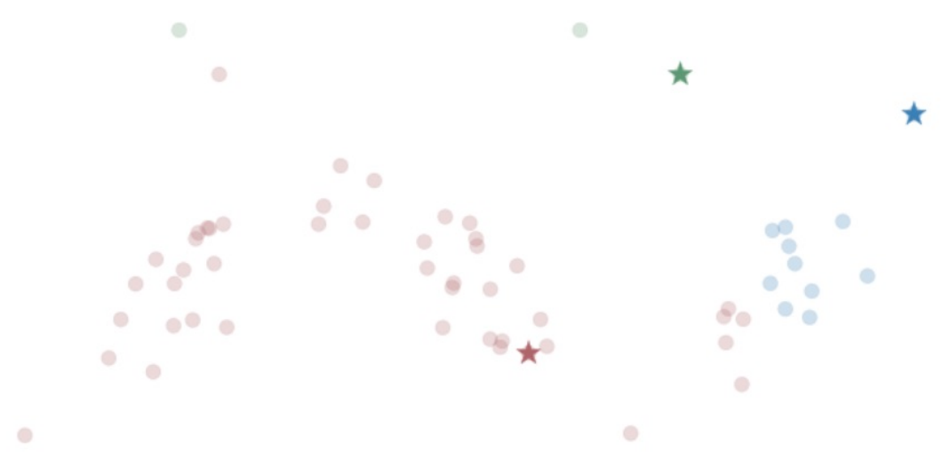
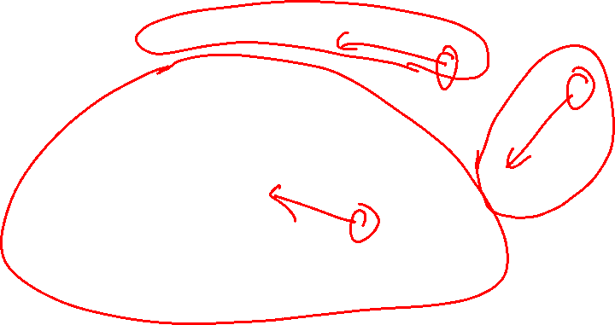
K Means - Outliers

Slide 74
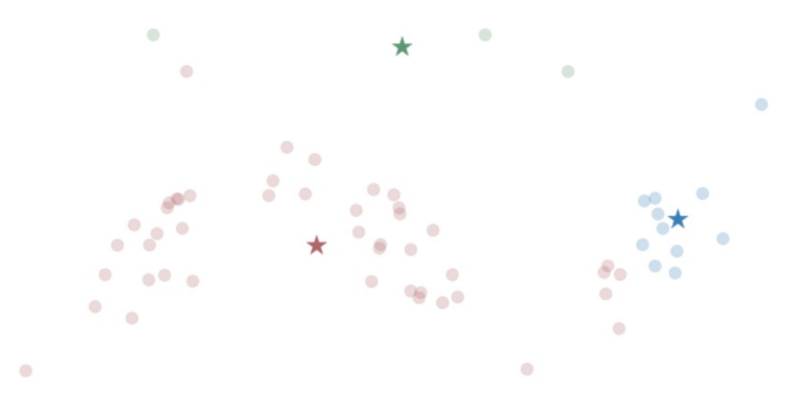
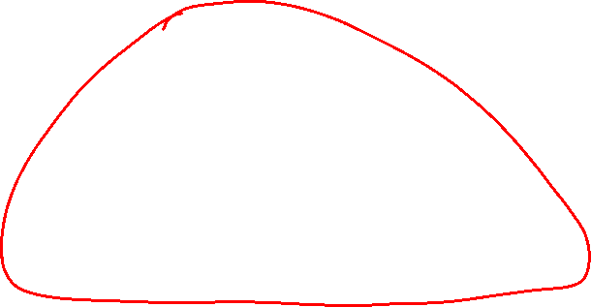
K Means – Outliers

Slide 75
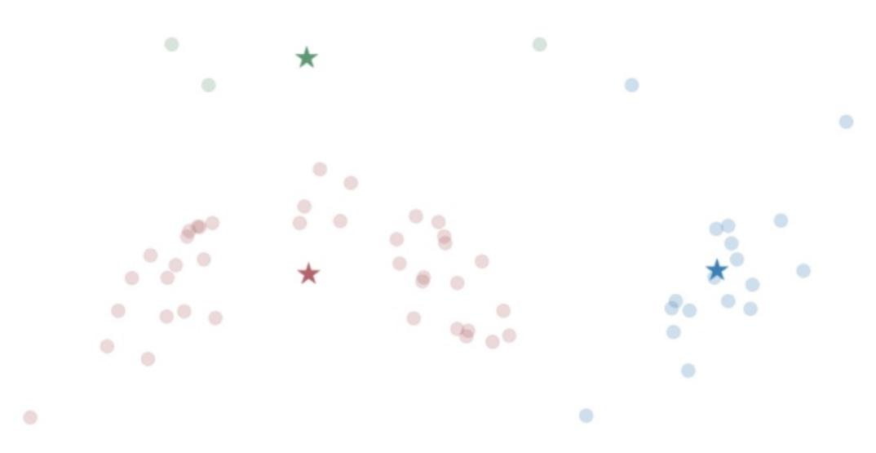

K Means – Outliers

Slide 76
K Means – Sensitive to Initial Centroids
K Means can be easily thrown off by outliers or nonlinearities
Can converge to a variety of points
- Converging to Local Minimum
Fix?

Slide 77
K Means – Sensitive to Initial Centroids
K Means can be easily thrown off by outliers or nonlinearities
Can converge to a variety of points
- Converging to Local Minimum
Fix?
Run several times (random initialization) and choose best

Slide 78
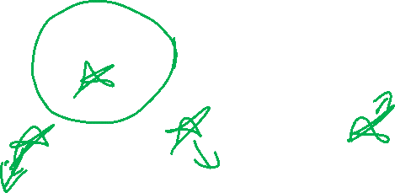
K Means - # Clusters

Slide 79
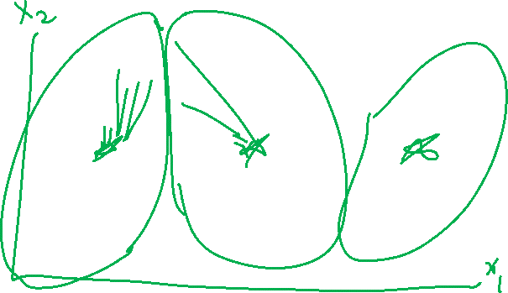
K Means - # Clusters
Choose a theoretically grounded value
- based on the “secret” ground-truth classification
- based on a hypothesis from other research
- based on prior work

Slide 80
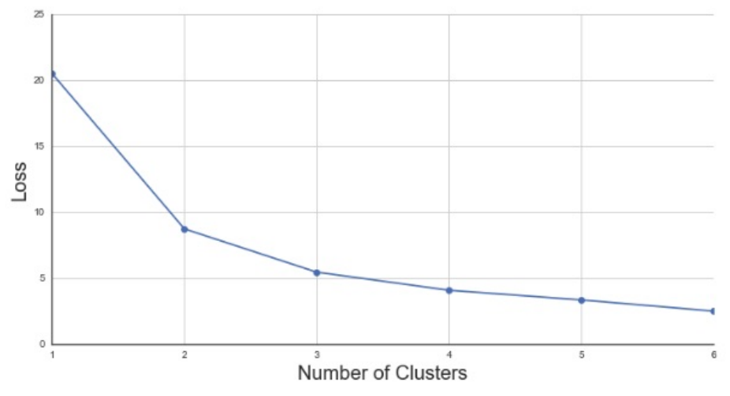
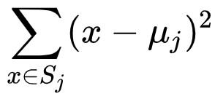
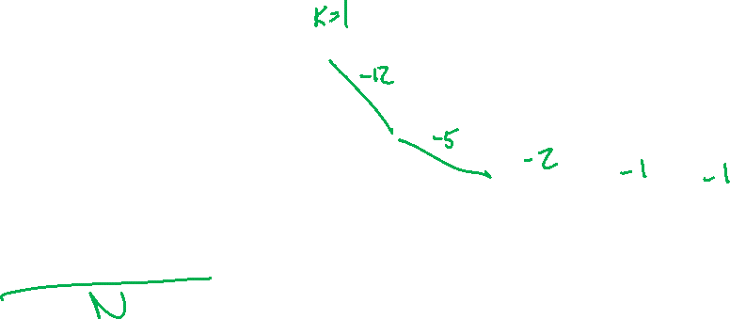
K Means - # Clusters
Elbow Method
- Choose the number of clusters with the most change in the derivative of the loss (i.e. choose the most bent elbow)
L2 Cost Function
Notes:
https://en.wikipedia.org/wiki/K-means_clustering

Slide 81
K Means – Categorical Data
Will this approach work?

Slide 82
K Means – Categorical Data
Solution: Encode same or different / create one-hot vectors

Slide 83
K Means – Categorical Data
Solution: Encode same or different / create one-hot vectors
Improvement: adjust distance based on how common an option is
- If 90% of your sample is non-smoking, being a smoking sample is more of an oddity, so perhaps it should differentiate a cluster

Slide 84
K Means – Categorical Data
Solution: Encode same or different / create one-hot vectors
Improvement: adjust distance based on how common an option is
- If 90% of your sample is non-smoking, being a smoking sample is more of an oddity, so perhaps it should differentiate a cluster
- K Means – adjust based on popularity for non-binary
- K Modes – simplify as binary, either most popular choice or not
https://shapeofdata.wordpress.com/2014/03/04/k-modes/

Slide 85
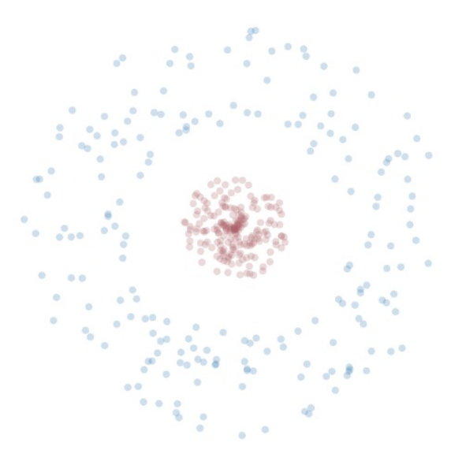
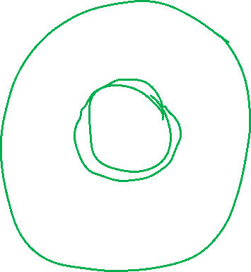
K Means – Non-Convex Clusters

Slide 86
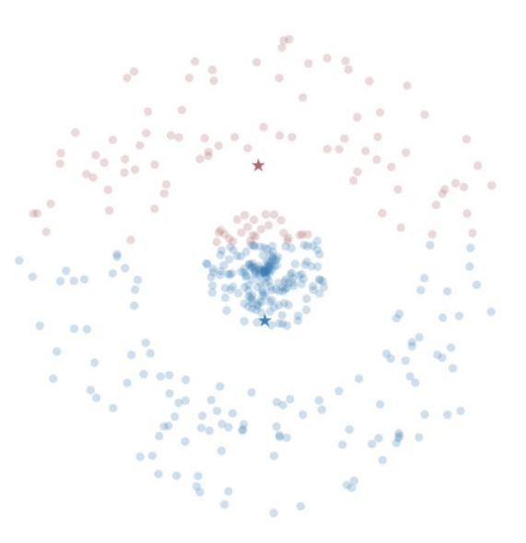
K Means – Non-Convex Clusters

Slide 87
K Means – Convex Clusters Solutions
Transform your data?

Slide 88
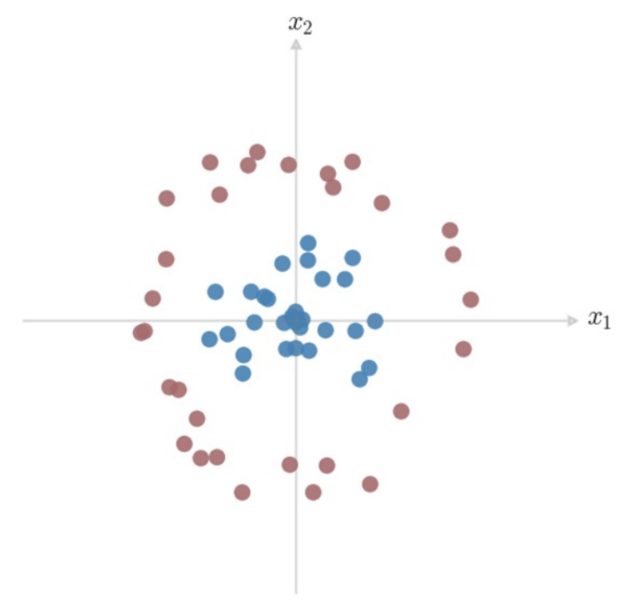
Dimension Projection
How would we separate these classes?
What kind of boundary can we give
this space?
Can we express that boundary in
terms of our given features?

Slide 89
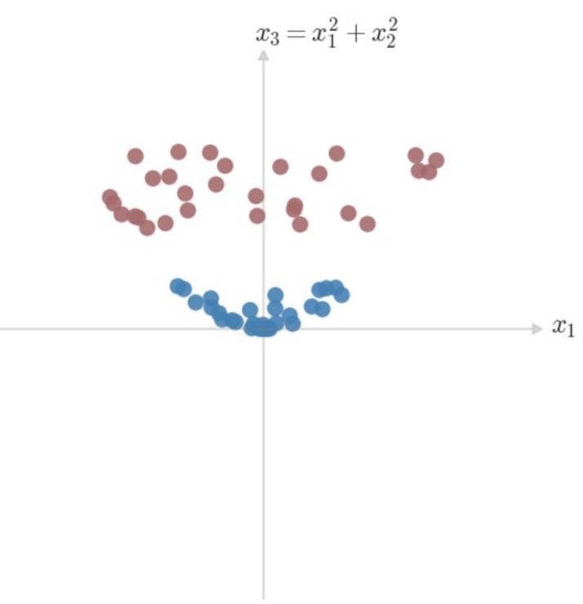
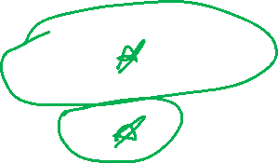
Dimension Projection
How would we separate these classes?
What kind of boundary can we give
this space?
Can we express that boundary in
terms of our given features?

Slide 90
K Means – Convex Clusters Solutions
Transform your data, add iterative testing?

Slide 91
K Means – Pros & Cons
PROS
Simple to understand & implement
Very fast to converge
Can make theoretical sense when mapping to cluster features

Slide 92
K Means – Pros & Cons
PROS
Simple to understand & implement
Very fast to converge
Can make theoretical sense when mapping to cluster features
CONS
Doesn’t handle non-convex clusters well
Sensitive to oddities from outliers, initialization
Makes a hard choice (assigns to one and only one cluster)

Slide 93
Clustering – K Means
Start with your Data
Choose K centroids
Until we converge:
Reassign points
Re-center

Slide 94
Generalizing K Means
Is there a way we can discuss clusters without a hard decision boundary?

Slide 95
Generalizing K Means
Is there a way we can discuss clusters without a hard decision boundary?
Add a probability to the assignment!

Slide 96
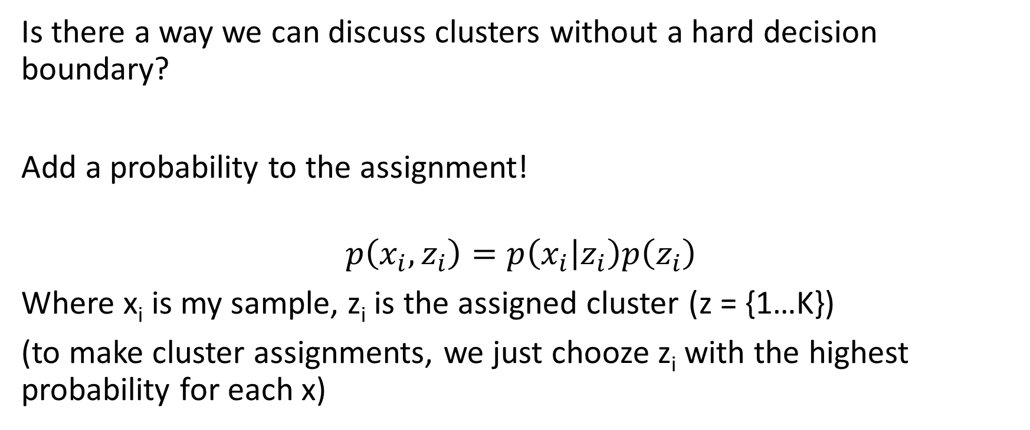
Generalizing K Means
Is there a way we can discuss clusters without a hard decision boundary?
Add a probability to the assignment!
$$p\left(x_{i},z_{i}\right)=p\left(x_{i} | z_{i}\right)p\left(z_{i}\right)$$
Where x_{i} is my sample, z_{i} is the assigned cluster (z = {1…K})
(to make cluster assignments, we just chooze z_{i} with the highest probability for each x)

Slide 97
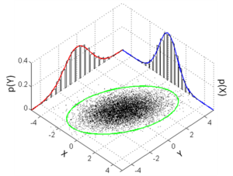
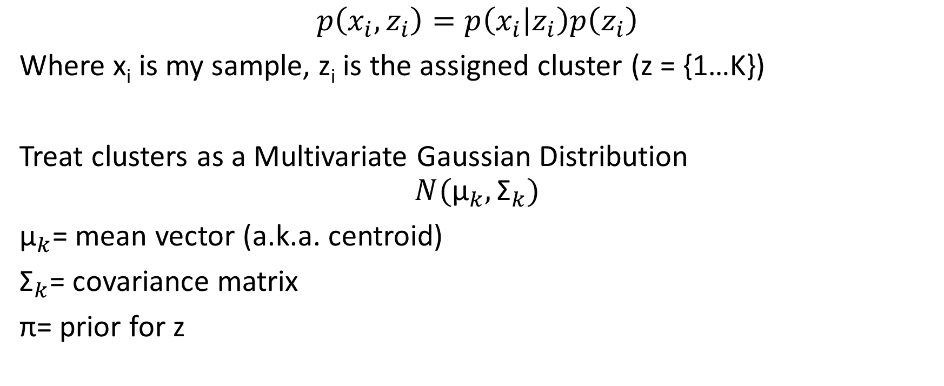
Generalizing K Means – Gaussian Distribution
$$p\left(x_{i},z_{i}\right)=p\left(x_{i} | z_{i}\right)p\left(z_{i}\right)$$
Where x_{i} is my sample, z_{i} is the assigned cluster (z = {1…K})
Treat clusters as a Multivariate Gaussian Distribution
$$N({\text{μ}}_{k},{\text{Σ}}_{k})$$
${\text{μ}}_{k}$= mean vector (a.k.a. centroid)
${\text{Σ}}_{k}$= covariance matrix
$\text{π}$= prior for z
Notes:
https://en.wikipedia.org/wiki/Multivariate_normal_distribution

Slide 98
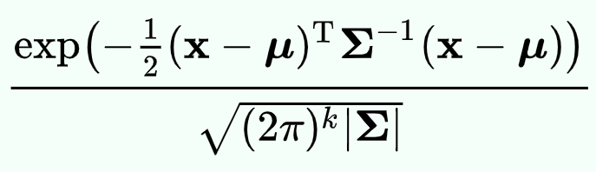


Generalizing K Means – Gaussian Distribution
$$p\left(x_{i},z_{i}\right)=p\left(x_{i} | z_{i}\right)p\left(z_{i}\right)$$
Where x_{i} is my sample, z_{i} is the assigned cluster (z = {1…K})
Treat clusters as a Multivariate Gaussian Distribution
$$N({\text{μ}}_{k},{\text{Σ}}_{k})$$
${\text{μ}}_{k}$= mean vector (a.k.a. centroid)
${\text{Σ}}_{k}$= covariance matrix
$\text{π}$= prior for z
$p\left(x | z_{i}=k\right)$=
Mahalanobis distance – “distance” from x to $\text{μ}$
*technically this is the square of the mahalanobis distance…
Notes:
https://en.wikipedia.org/wiki/Multivariate_normal_distribution

Slide 99
Gaussian Distribution – Gaussian Mixture Model
We can define the probability a set of points x is sampled from a multivariate gaussian…

Slide 100


Gaussian Distribution – Gaussian Mixture Model
We can define the probability a set of points x is sampled from a multivariate gaussian…
Let’s try to find a set (mixture) of gaussians that best model the data!

Slide 101

Gaussian Mixture Model – Maximum Likelihood
Define the log-likelihood of all our variables, and maximize that!
$$l(\text{π}\text{,}\text{μ}\text{,}\text{Σ}\text{)}$$

Slide 102

Gaussian Mixture Model – Maximum Likelihood
Define the log-likelihood of all our variables, and maximize that!
$l(\text{π}\text{,}\text{μ}\text{,}\text{Σ}\text{) = }\sum_{i=1}^{m}{log⁡(p(x_{i}|\text{π}\text{,}\text{μ}\text{,}\text{Σ}\text{)}}$)
But we also don’t have our cluster assignments (i.e. which element of $\text{π}\text{,}\text{μ}\text{,}\text{Σ}$ do we associate our x with)

Slide 103


Gaussian Mixture Model – Maximum Likelihood
Define the log-likelihood of all our variables, and maximize that!
$l(\text{π}\text{,}\text{μ}\text{,}\text{Σ}\text{) = }\sum_{i=1}^{m}{log⁡(p(x_{i}|\text{π}\text{,}\text{μ}\text{,}\text{Σ}\text{)}}$)
$$l(\text{π}\text{,}\text{μ}\text{,}\text{Σ}\text{) =}\sum_{i=1}^{m}{log}\sum_{k=1}^{K}{p(x_{i}|z_{k}=k,\text{π}\text{,}\text{μ}\text{,}\text{Σ}\text{)}}p(z_{k}=k|\text{π})$$

Slide 104

Gaussian Mixture Model – Maximum Likelihood
Define the log-likelihood of all our variables, and maximize that!
$l(\text{π}\text{,}\text{μ}\text{,}\text{Σ}\text{) = }\sum_{i=1}^{m}{log⁡(p(x_{i}|\text{π}\text{,}\text{μ}\text{,}\text{Σ}\text{)}}$)
$$l(\text{π}\text{,}\text{μ}\text{,}\text{Σ}\text{) =}\sum_{i=1}^{m}{log}\sum_{k=1}^{K}{p(x_{i}|z_{k}=k,\text{π}\text{,}\text{μ}\text{,}\text{Σ}\text{)}}p(z_{k}=k|\text{π})$$
But we can’t vary our cluster assignments and our variables $\text{π}\text{,}\text{μ}\text{,}\text{Σ}$

Slide 105


Gaussian Mixture Model – Expectation Maximization
Hold Z fixed, maximize our variables

Slide 106

GMM – EM in practice

Slide 107


GMM – EM in practice

Slide 108

GMM – EM in practice

Slide 109


GMM – EM in practice

Slide 110

GMM – EM in practice

Slide 111
Principal Components / Singular Value Decomposition

Slide 112

Classification of these data?
Can we predict?
Can we assign?
Can we identify?

Slide 113
Principal Components – A different objective
What is unique?
What makes an X?

Slide 114

Step 1 – Build a Linear Model Approximation
Implementation details are outlined in ESL Textbook

Slide 115

Recall : Gram-Schmidt Process

Slide 116

Step 1 – Build a Linear Model Approximation
End with the Singular Value Decomposition
$$X = UDV^{T}$$
X = our observations*
N (number of points) by p (dimensions)
U = orthog. matrix, left singular vector columns
N by p
D = diagonal matrix, singular values
p by p
V^{T} = orthog. matrix, right singular vect. columns
p by p
*obs. have been re-centered to a new origin

Slide 117

Step 2 – Extract the q principal components you seek
$X_{q} = U_{q}D_{q}$

Slide 118


PCA In Action

Slide 119

Was this the best fit?

Slide 120

Principal Surface Analysis
End objective – a smoothed curve that best approximates our data

Slide 121
Step 1 - Build a Linear Model Approximation

Slide 122

Step 2 – Bend it! (like Beckham?)
Iteratively:
Hold $λ$ fixed, enforce self consistency on your curve
$$f_{j}(λ)←E(X_{j} |λ(X)=λ);j=1, 2, . . . , p$$
Hold the curve fixed, minimize your $λ$ (find the closest point on the curve for each data point)
$${\hat{λ}}_{f}(x)←{argmin}_{λ′}||x−\hat{f}(λ′)||2$$

Slide 123

Principal Surface Analysis
End objective – a smoothed curve that best approximates our data

Slide 124

Kernel PCA

Slide 125

PCA Pros and Cons
Pros
Reduce Dimensionality
Produce a better separation
Cons
You lose any “Explainability” of your model
You can explain the PCA Process, but these principal components are not particularly actionable

Slide 126
An Application of Clustering
What I did last Summer

Slide 127
An Application of Clustering
What One portion of one of the projects I did last Summer a few years ago
Presented at Learning Analytics & Knowledge 2020

Slide 128

Trace Data from Student Solutions to Genetics Problems Reveals Variance in the Processes Related to Different Course Outcomes
Melanie E. Peffer, David Quigley, Liza Brusman, Jennifer Avena, Jennifer Knight
2020 Learning Analytics and Knowledge Conference
March 25, 2020
Please Tweet Questions/Comments! @Melanie_Peffer
Notes:
Thank you for attending my talk today! I’m very excited to share some of the work I’ve been doing at University of Colorado Boulder on how students solve genetics problems and how learning analytics can be used to generate new insights into student’s problem solving practices. To start, why do we care about genetics learning?

Slide 129

Problem Solving is Integral to Genetics Literacy
Problem Solving: process of finding a solution to an unstructured or complex situation
Genetics relies heavily on problem solving
No longer limited to classrooms
Problem solving tends to be difficult for students
Genetics problem solving is particularly challenging
https://www.technologynetworks.com/genomics/articles/genotype-vs-phenotype-examples-and-definitions-318446
@Melanie_Peffer
Notes:
Genetics is tough because of the necessity to reason across a variety of spatial levels, abductive reasoning (working backwards), usage of math/algebra, proportional reasoning, understanding of basic statistics (odds ratios)

Slide 130
Three Level Model of Processing During Problem Solving (Hofer, 2004)
Cognition
(Reading, Gathering Information)
Epistemic Cognition
Metacognition
(Reflecting, Planning, Monitoring)
@Melanie_Peffer
Notes:
Metacognition—crucial link for successful problem solving. Connects what learners know to how they think so that this can be applied to successful problem solving

Slide 131
Technological Solutions to Measuring Latent Constructs
Measurement of cognition via student traces
Epistemological beliefs about science as seen through inquiry practices
Expert/Novice studies of inquiry (Peffer & Ramezani, 2019)
Use of learning analytics for assessment of epistemological beliefs
NLP of discourse during inquiry (Peffer & Kyle, 2017; LAK ‘17 Best Paper Nominee)
K-means clustering of inquiry profiles (Peffer, Quigley, and Mowstofi, 2019; LAK ‘19)
@Melanie_Peffer
Notes:
Look at what students do as a proxy for how they are thinking/what they believe (stealth assessment)
Not a new idea—has been presented at LAK in the past
What about specifically in the context of problem solving?

Slide 132
Current Study
Working knowledge of genetics and ability to solve genetics problems is crucial in today’s society
Metacognition is a crucial skill in successful problem solving, but is difficult to measure
Prior work suggests that trace data can be used to understand latent constructs
Can trace data reveal cognitive processes in action during genetics problem solving?
@Melanie_Peffer

Slide 133
Methods
Participants
n = 295 undergraduate introductory genetics students
Intervention
Extra credit genetics problems
“Think aloud” protocol while solving
Outputs
Problem correctness
Genetics Concept Assessment (Smith, Wood, and Knight, 2008)
Final exam score
@Melanie_Peffer

Slide 134
Analysis
Coding
Emergent coding approach
Identified 19 processes that fell under 5 categories
@Melanie_Peffer

Slide 135
Methods
Category | Subcategories
Conclusion | Eliminating, Claiming
Metacognition | Monitoring, Checking, Planning
Orientation | Clarifying, Recalling Information, Identifying similarities between question types
Reasoning | Justifying answers with evidence, reasoning
Execution | Using Information, Calculating, Creating a visual representation, Restating the process
@Melanie_Peffer

Slide 136
Analysis
Coding
Emergent coding approach
Identified 19 processes that fell under 5 categories
Feature Transformation
Each process assigned a single letter code (CMORE)
Sequences of processes generated
Built counts of all possible action bigrams to capture sequences
Cluster Analysis
K-means clustering using Weka
Built clusters using bigram features
Cluster assignment related to outcomes
@Melanie_Peffer
Notes:
Final number of clusters decided using elbow method

Slide 137

Bigram Clustering Reveals Differences in Processes and Probability of Answering Problems Correctly
C=conclusion, M=metacognition, O=Orientation, R=Reasoning, E=Execution
@Melanie_Peffer
Notes:
Centroids for each feature, distribution of outcome variables

Slide 138
Bigram Clustering Reveals Differences in Processes and Probability of Answering Problems Correctly
C=conclusion, M=metacognition, O=Orientation, R=Reasoning, E=Execution
@Melanie_Peffer
Notes:
Found three clusters

Slide 139
Bigram Clustering Reveals Differences in Processes and Probability of Answering Problems Correctly
C=conclusion, M=metacognition, O=Orientation, R=Reasoning, E=Execution
@Melanie_Peffer
Notes:
Cluster 1: Smallest, had the most CM, MO, ME, OM, OE, RM, RE, EM steps (highlighted)

Slide 140
Bigram Clustering Reveals Differences in Processes and Probability of Answering Problems Correctly
C=conclusion, M=metacognition, O=Orientation, R=Reasoning, E=Execution
@Melanie_Peffer
Notes:
Cluster 2: RC, EE steps, similar probability of getting the problem correct, but lower scores on GCA and FE

Slide 141
Bigram Clustering Reveals Differences in Processes and Probability of Answering Problems Correctly
C=conclusion, M=metacognition, O=Orientation, R=Reasoning, E=Execution
@Melanie_Peffer
Notes:
Cluster 3: RE, EC – lowest probability of getting problem correct (statistically significant)

Slide 142
NLP Primer
Or – Everything* You Need To Know About Natural Language Processing
*just kidding – go take 5832 if this sparks your interest!

Slide 143
NLTK – the SKLearn of NLP
https://www.nltk.org/

Slide 144



Natural Language Processing – Applications
Sentiment Analysis Topic Modeling
Translation
Notes:
https://machinelearningmastery.com/applications-of-deep-learning-for-natural-language-processing/
https://s3.amazonaws.com/com.twilio.prod.twilio-docs/images/SentimentAnalysis.width-800.png
http://bigdata.ices.utexas.edu/wp-content/uploads/2015/01/LDA-concept.png
https://www.fbi.gov/image-repository/translation-keyboard-stock.jpg/@@images/image/large

Slide 145
Naïve Bayes Classification – Example (Week 1)
Positive | Negative | Negative | Negative | Positive
Great | Cool | Worst | Depressing | Cool
Love | Tired | Sad | Worst | Amazing
Best | Bad | Angry | No | Sweet

Slide 146
Natural Language Processing – Applications
Sentiment Analysis Topic Modeling
Translation
Notes:
https://machinelearningmastery.com/applications-of-deep-learning-for-natural-language-processing/
https://s3.amazonaws.com/com.twilio.prod.twilio-docs/images/SentimentAnalysis.width-800.png
http://bigdata.ices.utexas.edu/wp-content/uploads/2015/01/LDA-concept.png
https://www.fbi.gov/image-repository/translation-keyboard-stock.jpg/@@images/image/large

Slide 147


Topic Modeling
Clustering Technique
Associate similar documents
Example: Topics in Science

